Slide 1
Big Data Analysis of Nevada Business Using Hadoop & Hive
Yelp Open Dataset – Tempo-Spatial Business Analytics
CIS 4560 – Introduction to Big Data
California State University, Los Angeles
Instructor: Dr. Woo
Presented by: Ruben Chagollan
December 3, 2025

Slide 2
Project Objectives
Use Hadoop HDFS and Hive to process large Yelp business data
Perform Tempo-Spatial analysis focused on Nevada businesses
Identify business trends using SQL queries (ratings, categories, locations)
Visualize results using maps and charts
Publish dataset, queries, and results through GitHub for reproducibility

Slide 3
Yelp Open Dataset
Source: Yelp Dataset Challenge
URL: https://www.yelp.com/dataset
Total dataset Size: -8.4 GB (JSON + Photos)
Includes Busniess, check-in, user, and review data.
Converted raw JSON to CSV for hive loading
Analysis focused on Nevada businesses only due to resource limits.

Slide 4
Big Data Platform Configuration
Platform: Hadoop + Hive on university Big Data cluster
Cluster Nodes: 5 nodes (2 Master, 3 Worker)
HDFS Storage: Large storage support
CPU: Multi-core Intel processors
Memory: Distributed memory across nodes
Hive Version: SQL-like data analysis environment

Slide 5


System Workflow Architecture
Yelp JSON Dataset (8.4GB)
Convert JSON to CSV (Python)
Upload CSV to linux /tmp directory
Move into HDFS storage
Publish Code & Results to GitHub
Visualize Results
Run SQL Queries (Nevada filter)
Create Hive External Table

Slide 6
Query Results - Visualization
Top 10 Nevada Cities by business count

Slide 7
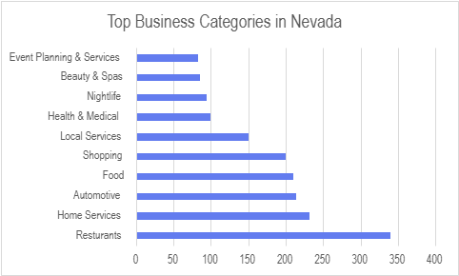
Query Results - Visualization
Key Insights
Restaurants are the most common business category in Nevada
Service-oriented industries (Home Services, Automotive, Local Services) dominate Yelp listings
Nightlife and Shopping businesses remain strong in tourism-focused areas
Source
Yelp Open Dataset – Hive SQL Query Results

Slide 8
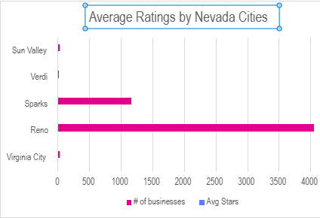
Average Yelp Ratings by Nevada Cities
Virginia City has the highest average rating among cities analyzed
Reno and Sparks show strong ratings with large business populations
Smaller towns like Verdi and Sun Valley have fewer but reasonably rated businesses
Source: Yelp Open Dataset – Hive SQL Query Results

Slide 9
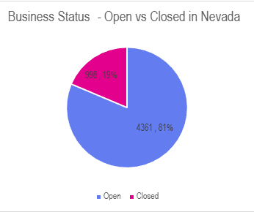
Business Status – Open vs Closed in Nevada
Most Nevada businesses in Yelp dataset are currently open
Closed businesses represent ~19% of listings
Reflects dynamic changes in local business activity
Source: Yelp Open Dataset — Hive SQL Query Results (Nevada)

Slide 10
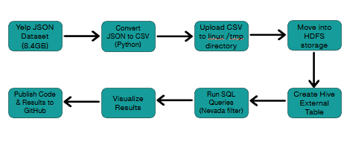
Implementation Summary
• Large Yelp JSON dataset downloaded (~8.4GB)
• Converted to CSV using a Python script
• Uploaded dataset to Linux /tmp directory
• Loaded data into HDFS distributed storage • Created Hive external table for SQL querying
• Filtered Nevada businesses for spatial analysis
• Executed HiveQL analytics and saved results
• Visualized final findings using Excel charts • Published code and dataset link on GitHub

Slide 11
GitHub Repository – Project Files & code
Github
URL: https://github.com/rchago7/yelp-nevada-analysis
Python Script used for data conversion
Hive SQL queries
Project Documentation & slides

Slide 12
Conclusion
• Successfully processed a large real-world dataset using Big Data tools
• Performed Tempo-Spatial analysis focused on Nevada businesses
• Identified key trends in business distribution, ratings, and categories
• Visualized insights to support local business understanding
• Demonstrated cloud-based Hive analytics and scalable workflows
This project shows how distributed data processing helps reveal meaningful patterns in community business activity.

Slide 13
References
• Yelp Open Dataset https://www.yelp.com/dataset
• GitHub Repository — Project Code & Documentation https://github.com/rchago7/yelp-nevada-analysis
• Apache Hive Documentation https://hive.apache.org/
• Hadoop Distributed File System (HDFS) Overview https://hadoop.apache.org/docs/stable/hadoop-project-dist/hadoop-hdfs/HdfsDesign.html
• Python CSV & JSON Libraries — Official Docs https://docs.python.org/3/library/csv.html https://docs.python.org/3/library/json.html

